Slide 1
Lecture 1.6 - Example Data Science Project 1: Apolo Graph Exploration
DLI Accelerated Data Science Teaching Kit

Slide 2

The Accelerated Data Science Teaching Kit is licensed by NVIDIA, Georgia Institute of Technology, and Prairie View A&M University under the
Creative Commons Attribution-NonCommercial 4.0 International License.

Slide 3
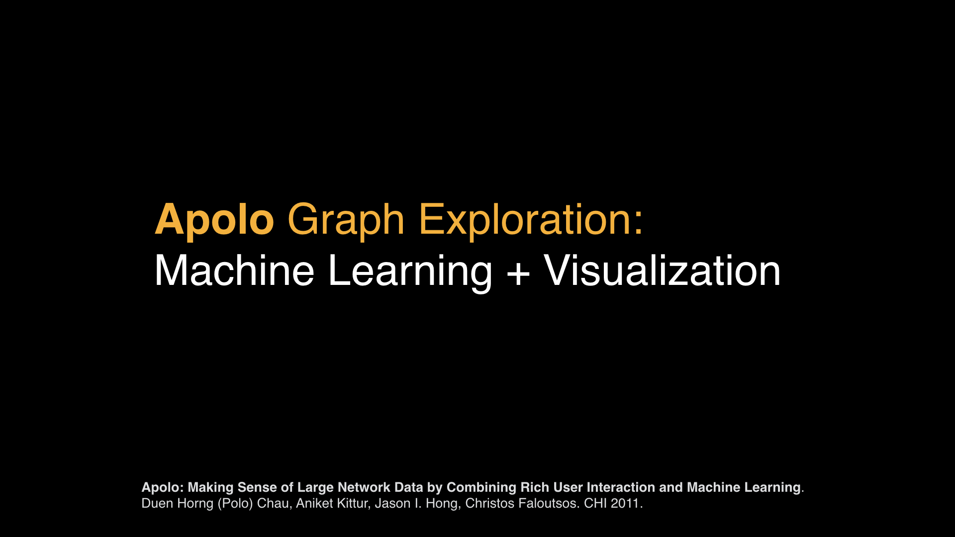

Slide 4
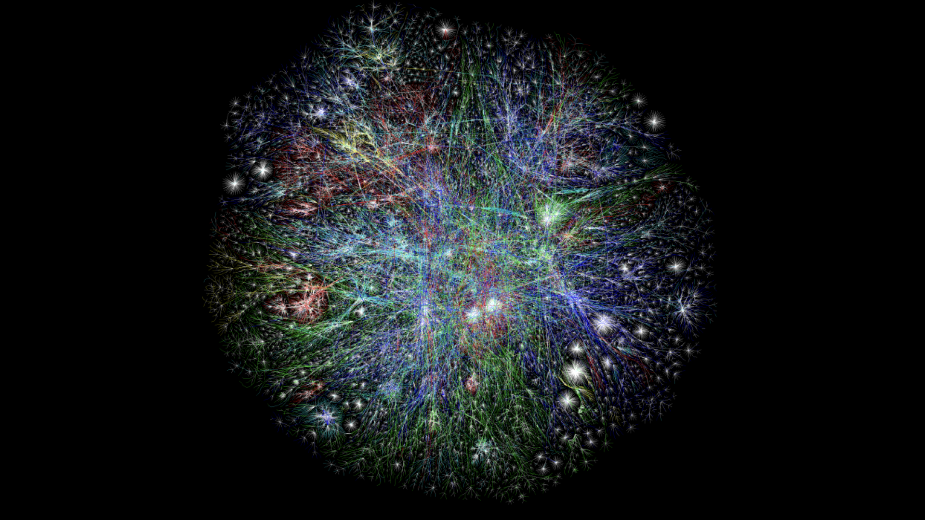
This work is licensed under a Creative Commons Attribution-NonCommercial 4.0 International License.
© 2014 by LyonLabs, LLC and Barrett Lyon. Hosted by Defense.Net

Slide 5

This work is licensed under a Creative Commons Attribution-NonCommercial 4.0 International License.
© 2014 by LyonLabs, LLC and Barrett Lyon. Hosted by Defense.Net

Slide 6
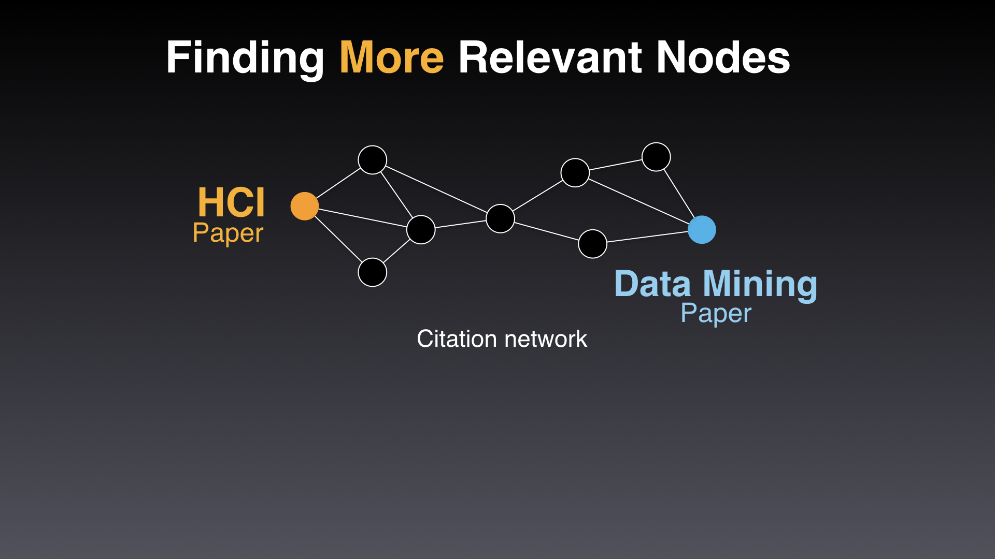

Slide 7
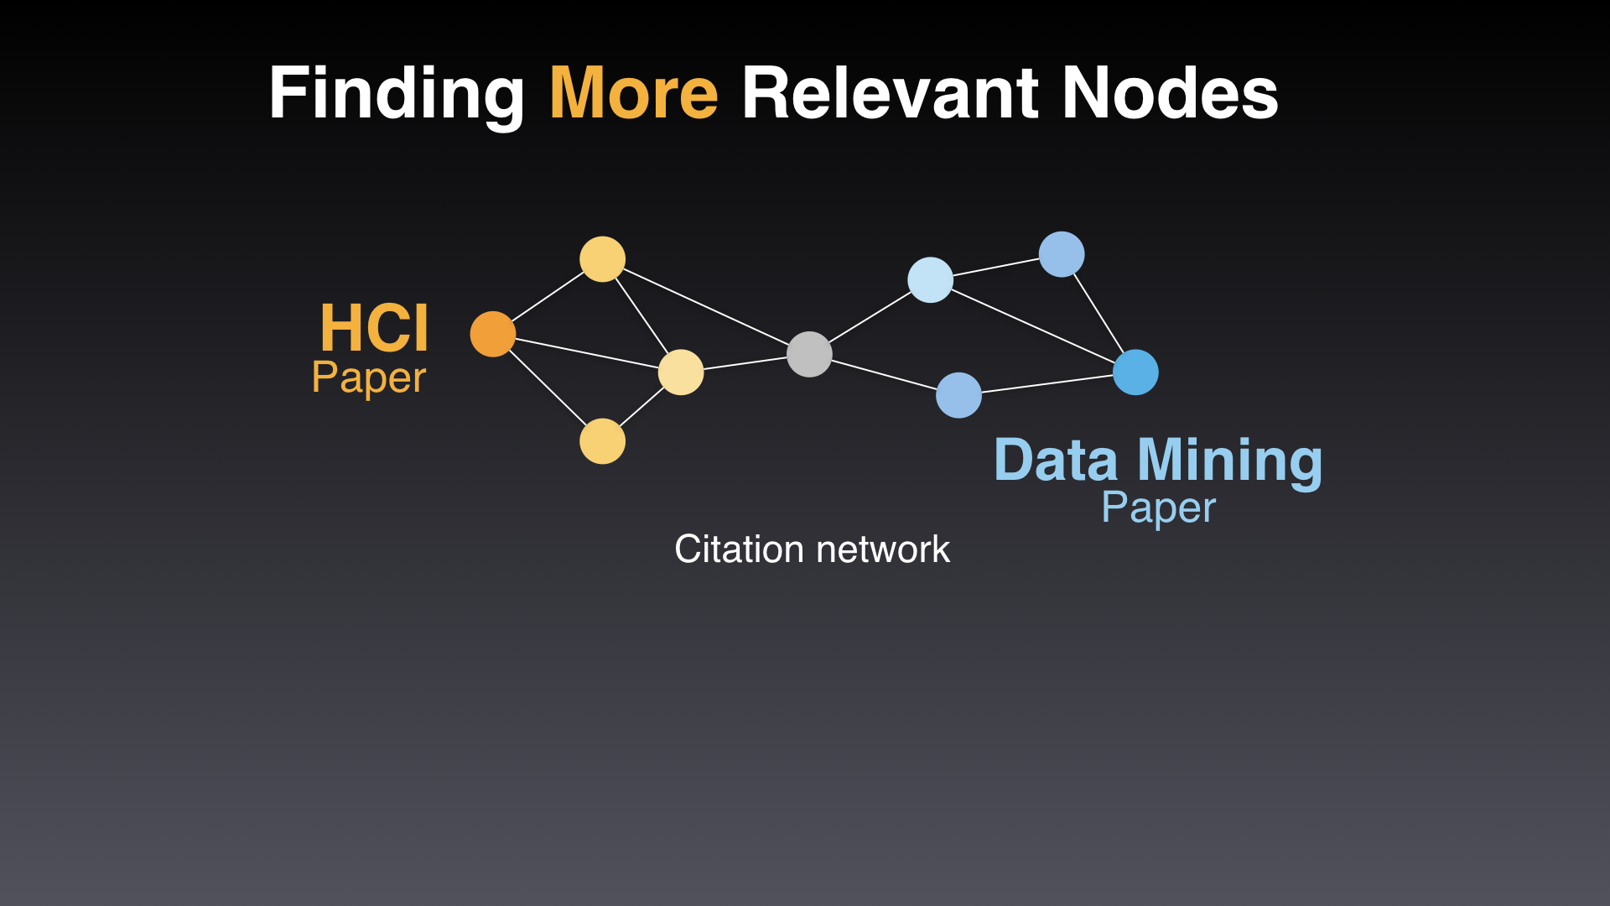

Slide 8
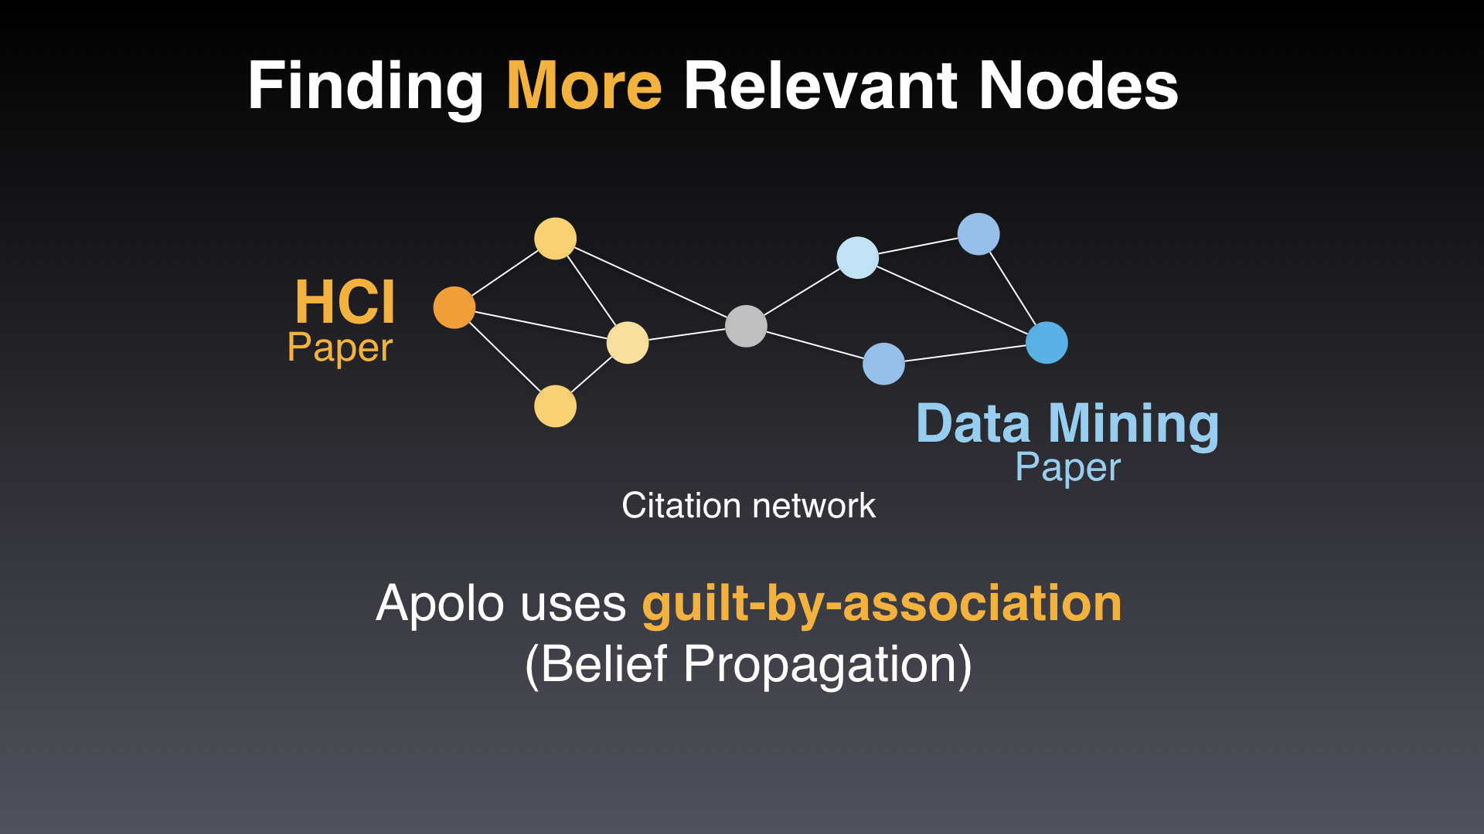

Slide 9
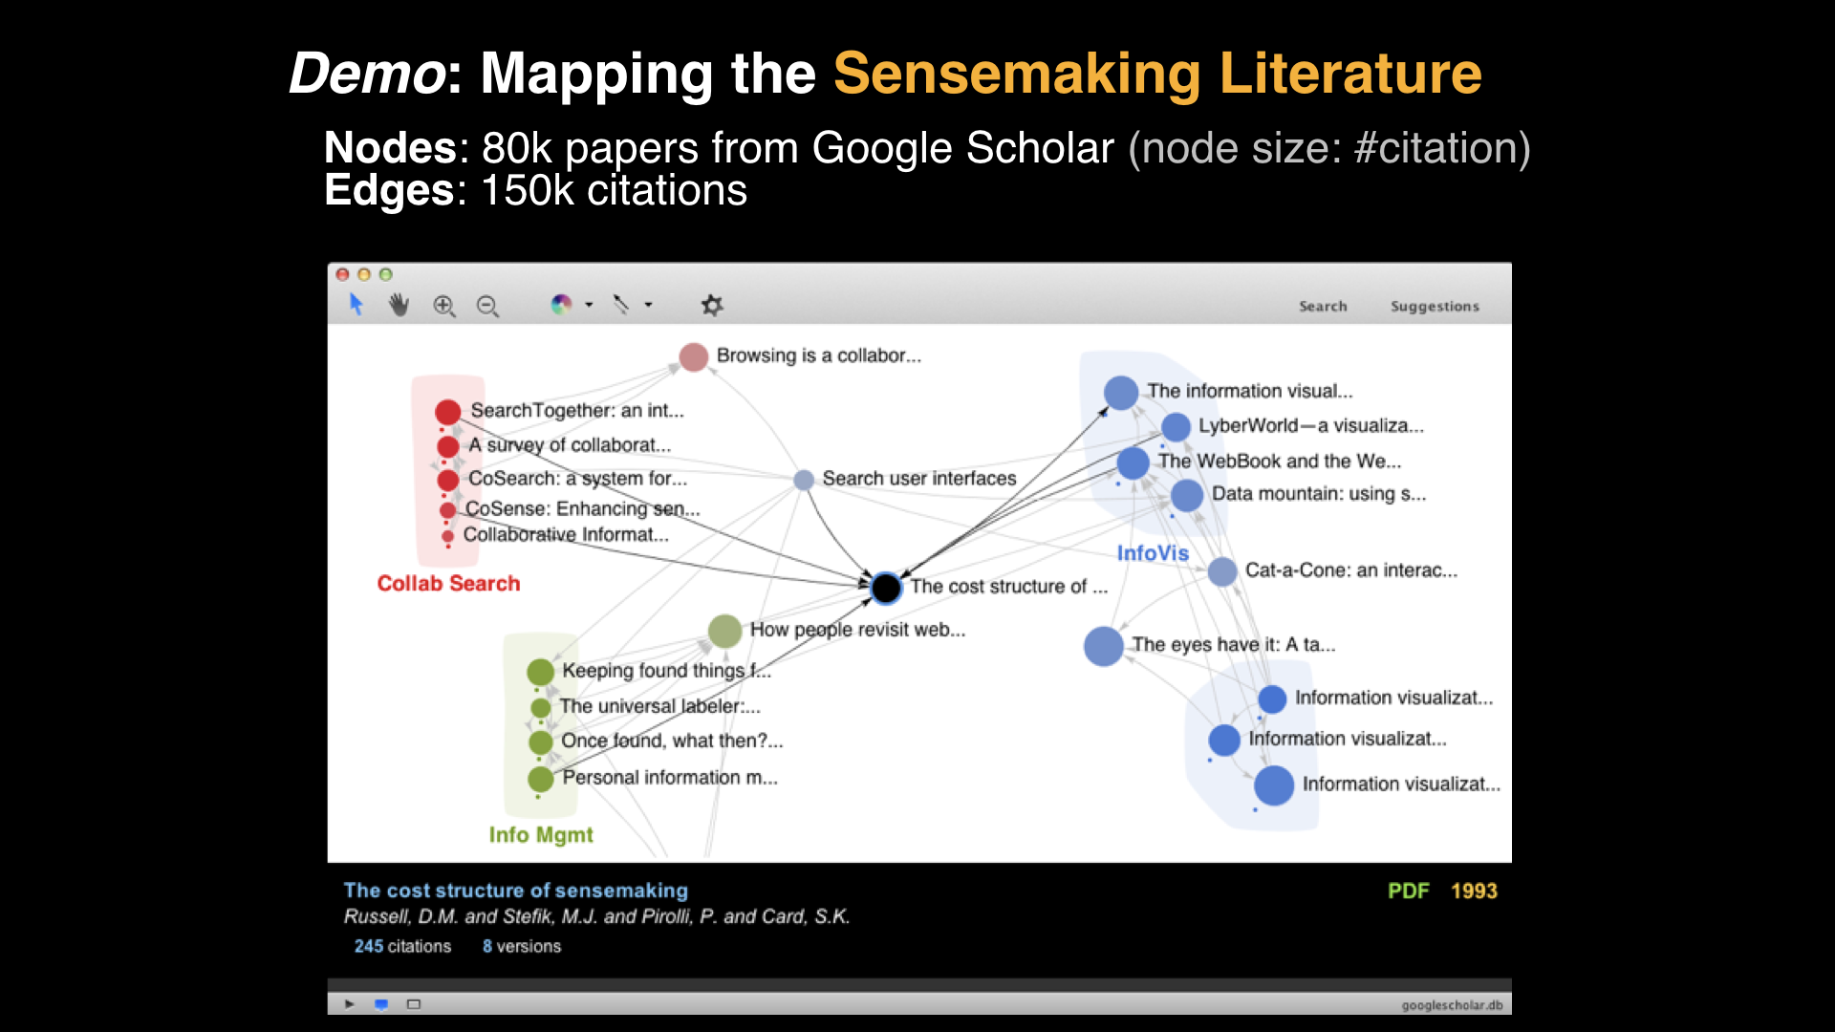
Notes:
Heading smaller in size.

Slide 10
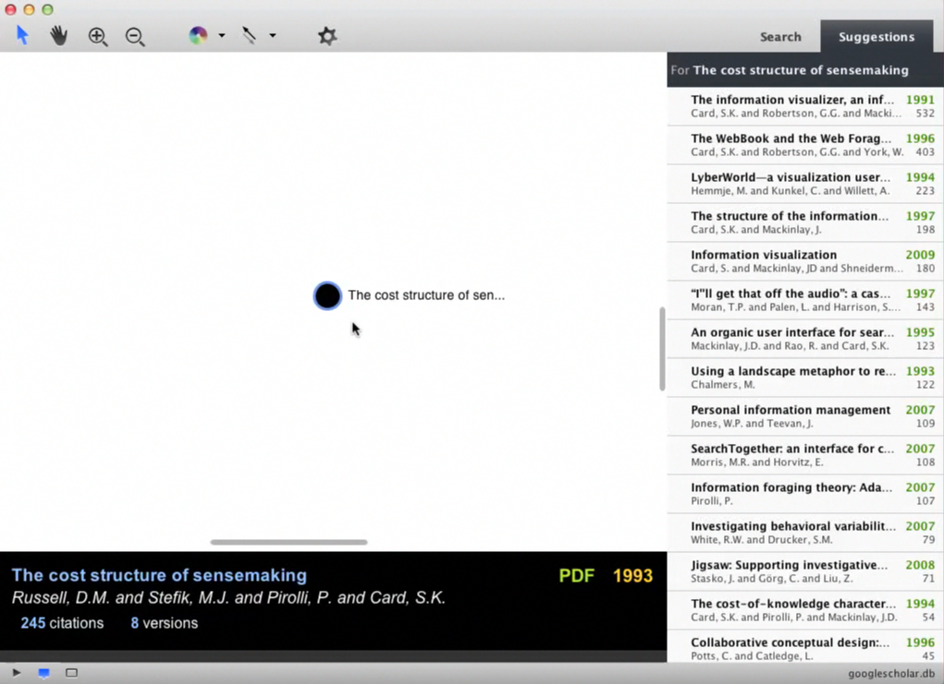
Notes:
Heading smaller in size.

Slide 11
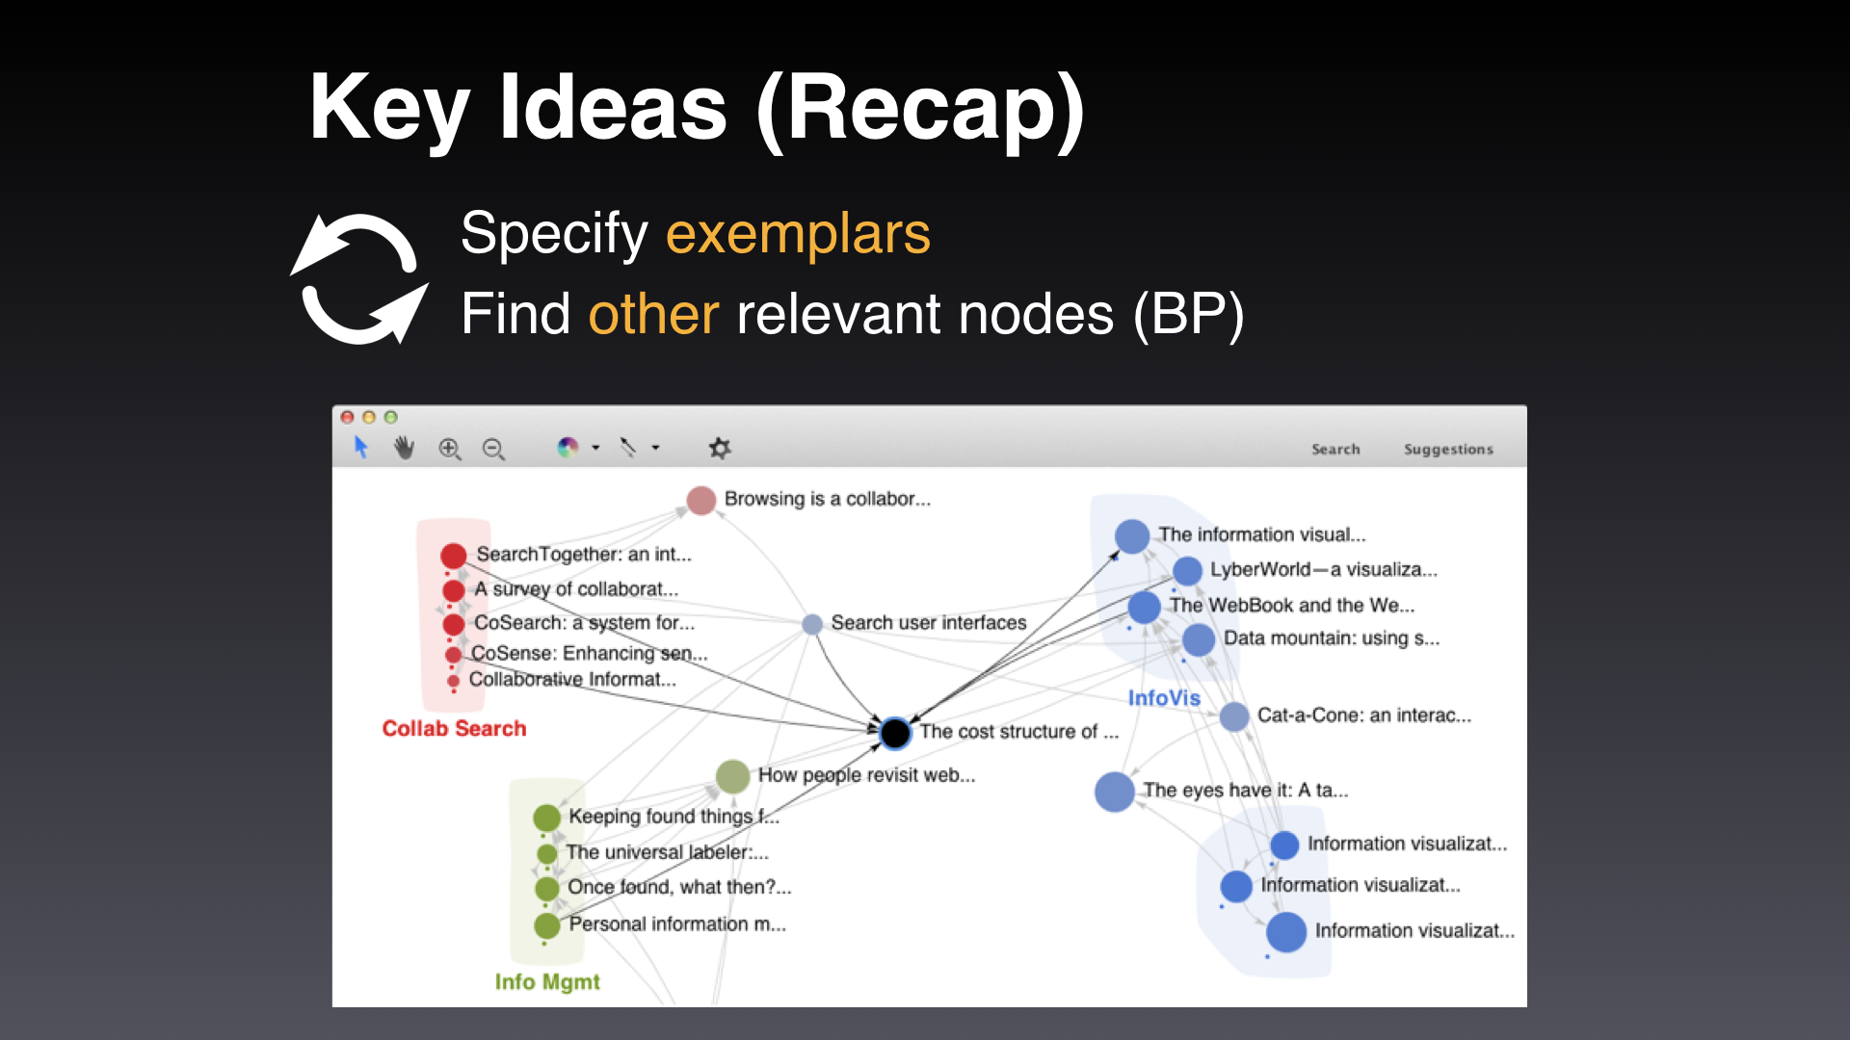

Slide 12
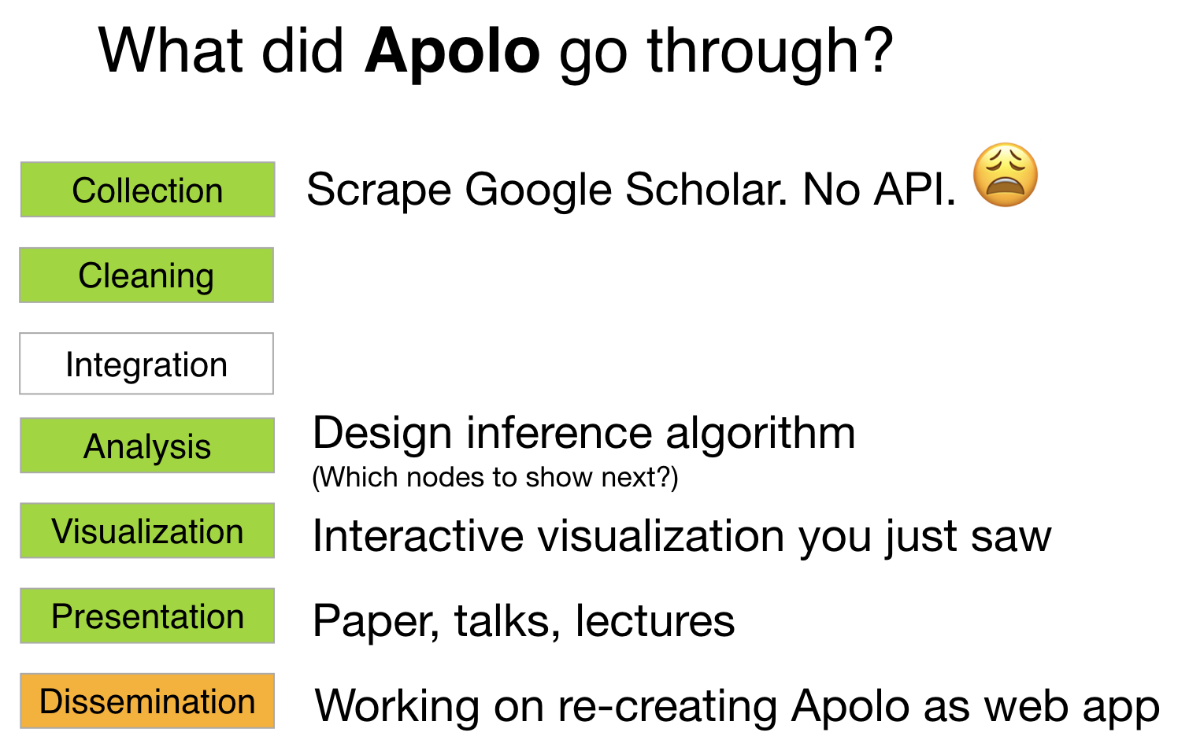

Slide 13
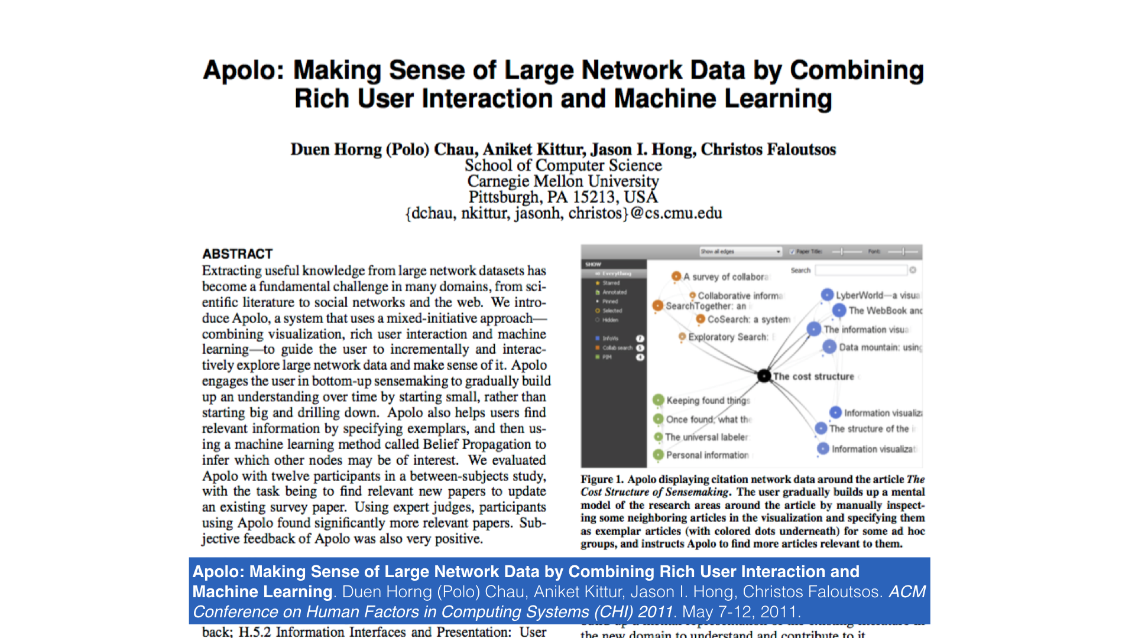

Slide 14
DLI Accelerated Data Science Teaching Kit
Thank You

